Slide 1
Drone Identification
By: Daya Kulkarni & Habeeb Salau

Slide 2
Overview
Use Case: (Scoped) – Recognize if object/person and do trick based on classification
Use Case (Full Scale)- recognize specific person and delivery medicine, recognize lost people (hikers), Bring food/drinks from concession stand to people in theaters, retail product confirmation/retrieval,

Slide 3
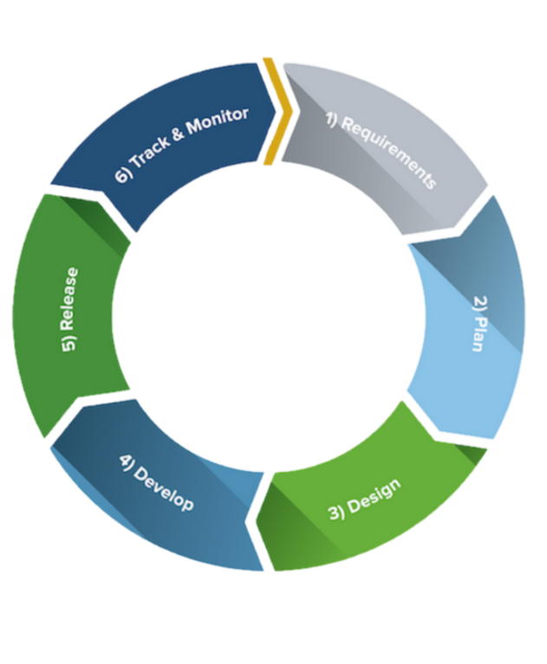
Methodology/Approach
Agile Process

Slide 4
Technologies
Software:
Pre-trained Yolov3 Object detection model
OpenVINO Tool Kit (Model Optimizer)
Hardware:
Drone – DJI Tello EDU
Neural Compute Stick 2
Up Squared Box/Board

Slide 5
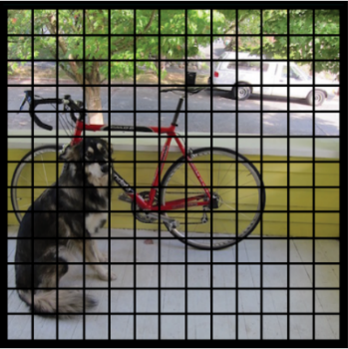
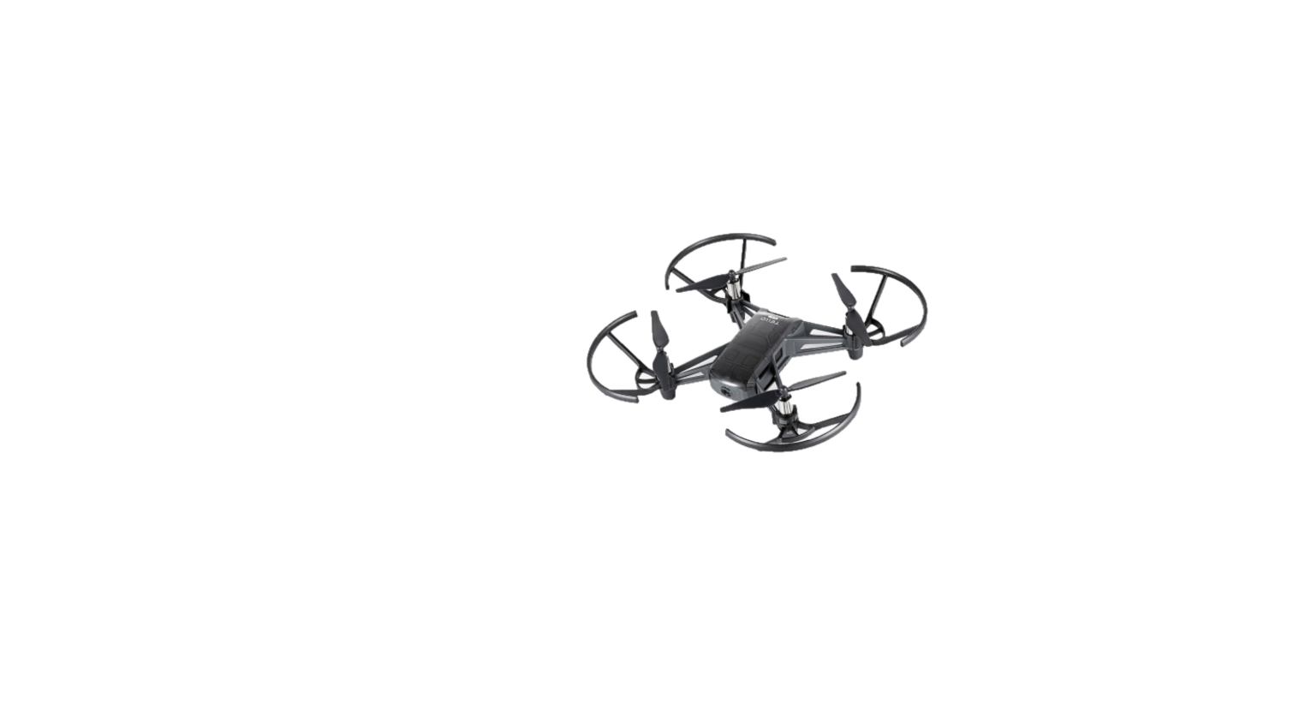

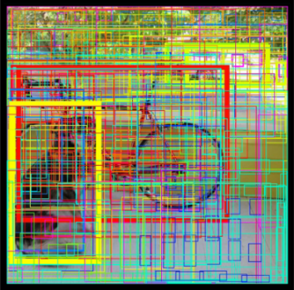
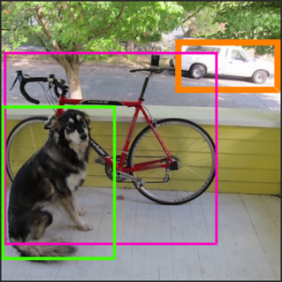
How it Works
DJI Tello Drone
YOLOV3 Object Detection Model
Neural Compute Stick
DJI Tello SDK
DJI Tello Libraries
Programmable python commands
Optimizer
Optimizer

Slide 6
Videos/Photos/Repo
Repo: https://github.com/daya-kulkarni/Intel-Drone-Project

